Slide 1

Lecture 1 Cyber Security Essentials 20CYS114
-Saurabh Shrivastava
TIFAC Core in Cyber Security
Amrita Vishwa Vidyapeetham

Slide 2
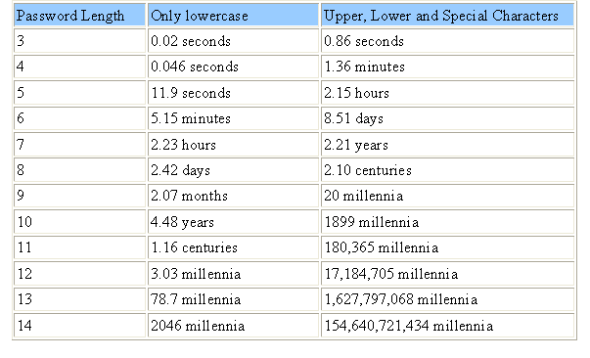

Slide 3

What is Cyber Safety?

Slide 4
What is Cyber Safety?
Personal safety issues, such as cyberstalking, cyberbullying, online predators.
Information security issues, such as phishing, identity theft, and scams.
Computer threats, such as hackers, viruses, and other malicious software.
Content issues, such as obscene or offensive content.

Slide 5
Cyberstaking and Cyberbullying
Cyberstalking is stalking or harassment carried out over the internet.
Cyberbullying is bullying with the use of digital technologies. It can take place on social media, messaging platforms, gaming platforms and mobile phones. It is repeated behaviour, aimed at scaring, angering or shaming those who are targeted.

Slide 6
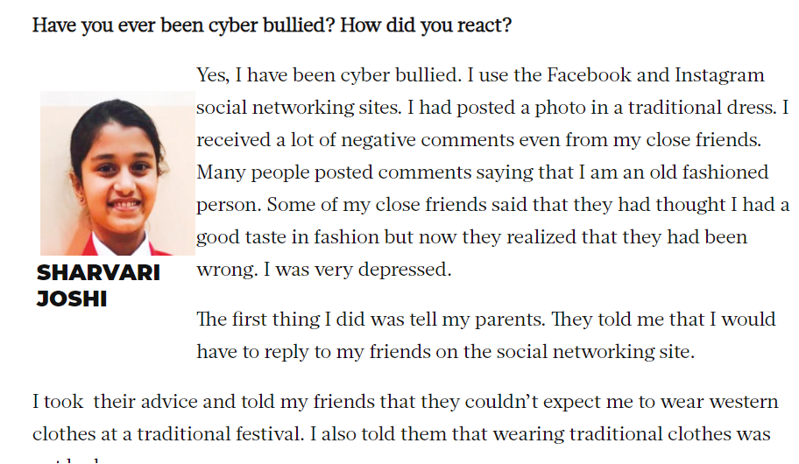
Cyberbullying

Slide 7
How to avoid?
Keep a low profile.
Update your software.
Maintain a good digital hygiene.
Avoid disclosing sensitive information.

Slide 8
Phishing and Identity Theft
Phishing is a cybercrime in which a target or targets are contacted by email, telephone or text message by someone posing as a legitimate institution to lure individuals into providing sensitive data such as personally identifiable information, banking and credit card details, and passwords.
Spam Phishing and Spear Phishing (Whaling)
Identity theft is the crime of obtaining the personal or financial information of another person to use their identity to commit fraud, such as making unauthorized transactions or purchases.

Slide 9
Hackers
White hat hackers, also known as ethical hackers
Black hat hackers - malicious intent
Gray hat hackers
-> more likely than white hat hackers to access systems without authorization.
-> more likely than black hat hackers to avoid doing unnecessary damage to the systems they hack.

Slide 10

Malwares
Shorthand for malicious software, malware typically consists of code developed by cyberattackers, designed to cause extensive damage to data and systems or to gain unauthorized access to a network.
Types
-> Viruses
-> Worms
-> Trojan Horse
-> Ransomware etc….

Slide 11
Social Engineering
Social engineering is the art of exploiting human psychology, rather than technical hacking techniques, to gain access to buildings, systems or data.
Tailgating
Shoulder Surfing
Dumpster Diving
Quid Pro Quo
Watering Hole Attacks

Slide 12
References:
https://www.tripwire.com/state-of-security/security-awareness/what-cyberstalking-prevent/
https://www.unicef.org/end-violence/how-to-stop-cyberbullying
https://www.phishing.org/what-is-phishing#:~:text=Phishing%20is%20a%20cybercrime%20in,credit%20card%20details%2C%20and%20passwords.
https://www.investopedia.com/terms/i/identitytheft.asp#:~:text=Identity%20theft%20is%20the%20crime,making%20unauthorized%20transactions%20or%20purchases.
https://searchsecurity.techtarget.com/definition/hacker
https://usa.kaspersky.com/resource-center/definitions/what-is-social-engineering
https://gulfnews.com/going-out/society/cyber-bullying-hear-it-from-victims-in-uae-1.2224629

